Slide 1
Mid Semester Exam Solution

Slide 2
Q.1 d
S = 20; // maximum number of request that can be handled
mutex = 1;
Secretary () {
while(true) {
wait(S);
wait(mutex);
Critical Section
signal(mutex);
signal(S);
}
}

Slide 3
Q.1 e X=2
F1 Y=X+2 X=3*y | F2 Z=3*X X=Z+2
F1 and F2 Y=4, X=12, Z=36, X= 38
F1 first instruction and F2 Y=4, Z=6, X=8, X=24
First instruction of each and then second. Y=4, Z= 6, X=12, X=8
F2 and then F1. Z= 6, X=8, Y=10, X=30
F2 first instruction and F1= Z=6, Y=4, X=12, X=8
Z=6, Y=4, X=8, X=24

Slide 4
Q.1 f
10 processes -> 1 min 1 process-> 1/10 min = 6 sec (Arrival rate) Each process -> 3 sec service time 3/6 * 100 = 50% of time CPU is busy

Slide 5
Q.2 a
Actors : coffee junkies, register, and workers.
You would initialize any number of junky threads, one register thread, and three worker threads.
Junky : wait for cash register, place order, wait for order, get coffee
register: wait for customer, get order, pass order to worker, repeat
worker: wait for order from register, process order, pass it to customer, repeat
Register to worker synchronization is like producer consumer. Assume infinite buffer.
Junky queues up for coffee (waits on cash register sempahore initialized to 1), then waits for the order semaphore signalled by the workers

Slide 6
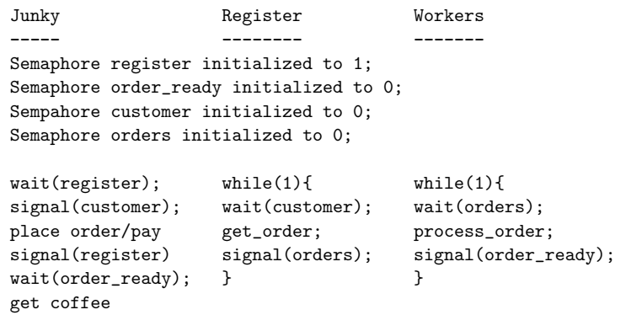
Q.2 a

Slide 7
Q.2 a
Essentially, you want to associate orders with customers. Since the customers have mutual exclusion at the register via the register semaphore, we can in there associate a ticket number with them that gets increased with every order.
Similarly, the workers can increment the order number (need to add a lock on that since currently the workers don’t have a mutual exclusion portion of their code).
The ready orders can be tagged into a linked list (with mutual exclusion).
The waiting customers could wait on a condition lock with condition their order being in the linked list.
Every time an order is done, we broadcast to the waiting customers to check if their order is ready.
All accesses to the linked list of orders have to have mutual exclusion.

Slide 8
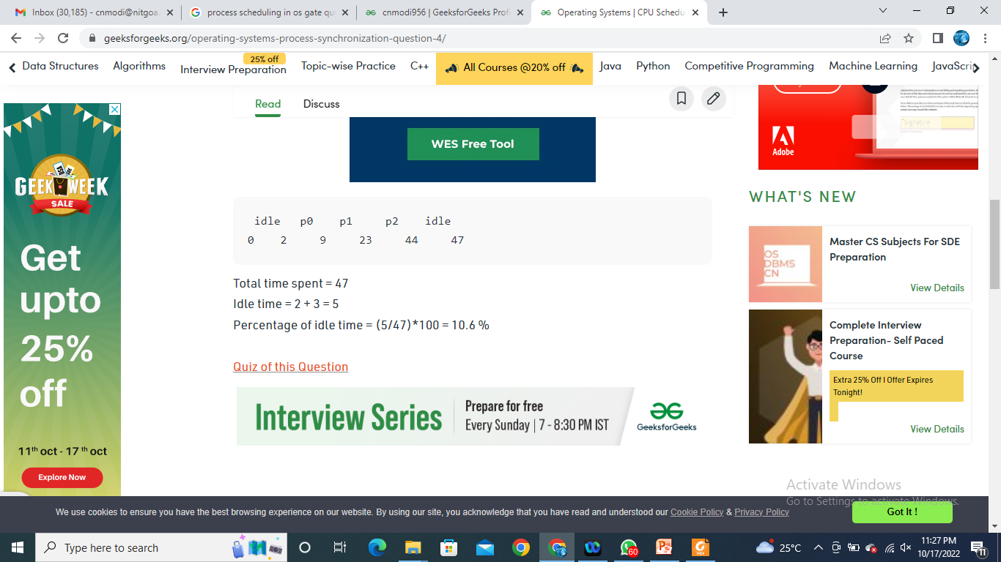
Q.2 b
p0, p1 and p2- execution time is 10, 20 and 30 respectively.
p0 spends first 2 time units in I/O, 7 units of CPU time and finally 1 unit in I/O.
p1 spends first 4 units in I/O, 14 units of CPU time and finally 2 units in I/O.
p2 spends first 6 units in I/O, 21 units of CPU time and finally 3 units in I/O.
Total time spent = 47 Idle time = 2 + 3 = 5 Percentage of idle time = (5/47)*100 = 10.6 %

Slide 9
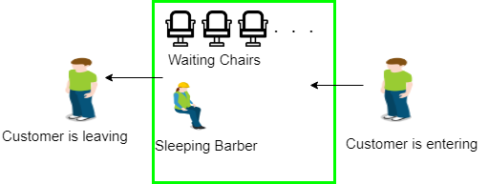
Q.3 a

Slide 10
Q.3 a
Three semaphores 1) For the customer which counts the number of customers present in the waiting room (customer in the barber chair is not included because he is not waiting) 2) the barber 0 or 1 is used to tell whether the barber is idle or is working, 3) mutex is used to provide the mutual exclusion which is required for the process to execute
The customer has the record of the number of customers waiting in the waiting room if the number of customers is equal to the number of chairs in the waiting room then the upcoming customer leaves the barbershop.
When the barber shows up in the morning, he executes the procedure barber, causing him to block on the semaphore customers because it is initially 0. Then the barber goes to sleep until the first customer comes up.

Slide 11
Q.3 a
When a customer arrives, he executes customer procedure the customer acquires the mutex for entering the critical region, if another customer enters thereafter, the second one will not be able to anything until the first one has released the mutex. The customer then checks the chairs in the waiting room if waiting customers are less then the number of chairs then he sits otherwise he leaves and releases the mutex.
If the chair is available then customer sits in the waiting room and increments the variable waiting value and also increases the customer’s semaphore this wakes up the barber if he is sleeping.
At this point, customer and barber are both awake and the barber is ready to give that person a haircut. When the haircut is over, the customer exits the procedure and if there are no customers in waiting room barber sleeps.

Slide 12
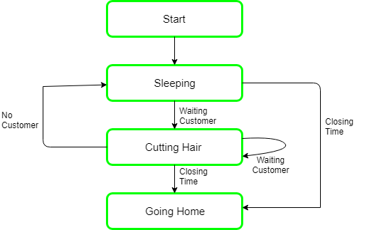
Q.3 a

Slide 13
Q.3 a
Semaphore Customers = 0;
Semaphore Barber = 0;
Mutex Seats = 1;
int FreeSeats = N;

Slide 14
Q.3 a
Barber {
while(true) {
/* waits for a customer (sleeps). */
down(Customers);
/* mutex to protect the number of available seats.*/
down(Seats);
/* a chair gets free.*/
FreeSeats++;
/* bring customer for haircut.*/
up(Barber);
/* release the mutex on the chair.*/
up(Seats);
/* barber is cutting hair.*/
}
}

Slide 15
Q.3 a
Customer {
while(true) {
/* protects seats so only 1 customer tries to sit in a chair if that's the case.*/
down(Seats);
if(FreeSeats > 0) {
/* sitting down.*/
FreeSeats--;
/* notify the barber. */
up(Customers);
/* release the lock */
up(Seats);
/* wait in the waiting room if barber is busy. */
down(Barber);
// customer is having hair cut
} else {
/* release the lock */
up(Seats);
// customer leaves
}
}
}

Slide 16
Q.3 b
There are three processes A, B and C that run in round robin manner with time slice of 50 ms.
Processes start at 0, 5 and 10 milliseconds.
The processes are executed in below order A, B, C, A 50 + 50 + 50 + 50 (200 ms passed)
Now A has completed 100 ms of computations and goes for I/O now
B, C, B, C, B, C 50 + 50 + 50 + 50 + 50 + 50 (300 ms passed)
C goes for i/o at 500ms and it needs 500ms to finish the IO.
So C would complete its first IO at 1000 ms

Slide 17
Q.3 C
10, 11

